Slide 1
Notes:
Part 2 of 3. This presentation covers the information required to complete PASS criteria of the LO2 Map Reading topic.
For best results, these instructor notes should be read in conjunction with this presentation and the lesson plan.

Slide 2
LEARNING OUTCOMES
LO2: Know the scales and features of Ordnance Survey maps.
Use grid referencing systems on Ordnance Survey maps to find locations.
Notes:
LO2: Know scales and features of Ordnance Survey maps.
P3: Use grid referencing systems on Ordnance Survey maps to find locations.

Slide 3
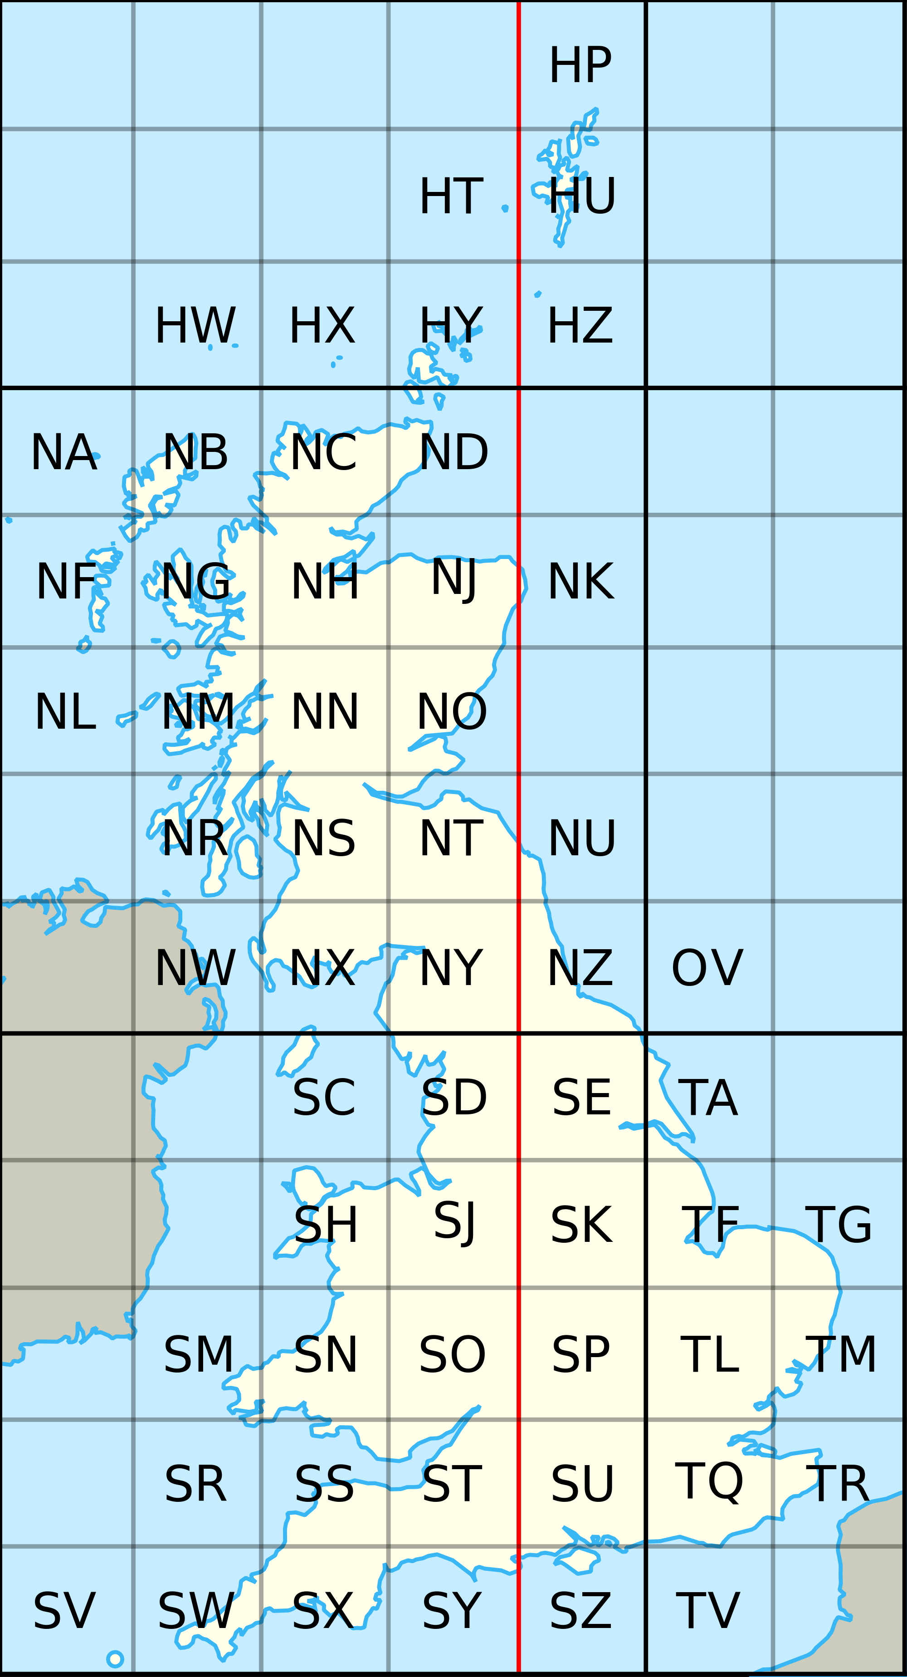
THE NATIONAL GRID
Resource Book
Page 72
Each country has their own ‘national grid’.
The UK is covered in a grid of 100km x 100km grid squares.
Each square is represented by two letters.
Notes:
The Ordnance Survey National Grid reference system is a system of geographic grid references used in Great Britain, different from using Latitude and Longitude. It is often called British National Grid.
Each OS map has it’s own 2-letter designation.

Slide 4
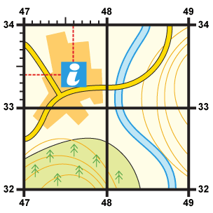
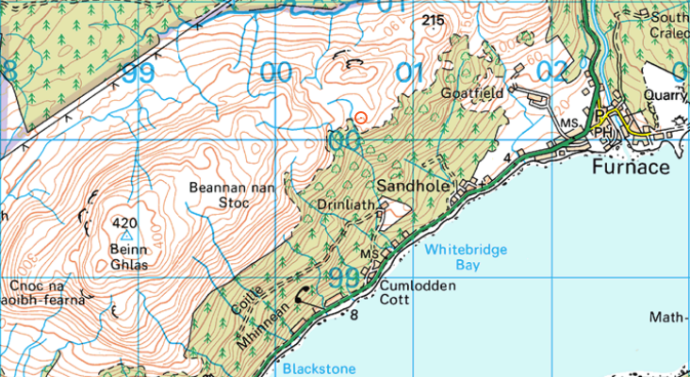
GRID SQUARES
Resource Book
Page 72
Every Ordnance Survey map is covered in a series of grids.
By learning to use these grids we are able to locate a particular point on a map.
Notes:
Every OS map is covered in blue lines which form grids over the map.

Slide 5
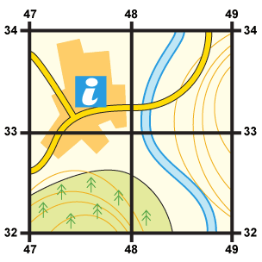
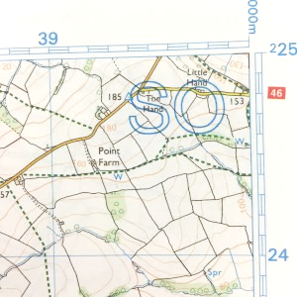
GRID SQUARES
Resource Book
Page 72
Grid lines on an OS map are spaced 1km apart no matter what the scale. This makes it easy to judge the rough distance between counting squares.
Horizontal lines are called Northings.
Vertical lines are called Eastings.
Each line has a number, based on the 100km square it belongs in.
Northings
Eastings
Notes:
All OS maps have 1km grid squares which help measure distance easily. Each grid square has its own number, which comprises of two 2 digit numbers.
Each map contains vertical and horizontal lines. The horizontal lines are called Northings and the vertical lines are called Eastings.
The number printed against each vertical line indicates the number of kilometres that line is east of the starting point for the 100km square to which your map belongs. The number printed against the horizontal grid line indicates the number of kilometres the line is north of the same starting point.

Slide 6
4-FIGURE GRID REFERENCES
Resource Book
Page 72
Each 1km square has it’s own 4 figure ‘grid reference’.
You can use the numbers from the eastings and northings to find it.
Find the eastings first : ‘along the corridor’.
Then the northings: ‘up the stairs’ .
Northings
Eastings
Notes:
It is fairly easy to locate an object within a 1km square as long as you know what square it is in. This can be done using Easting and Northing to indicate the south west (SW) corner of the square you wish to identify. By using the SW corner of the square, the grid reference is standardised so everyone knows what it means.

Slide 7
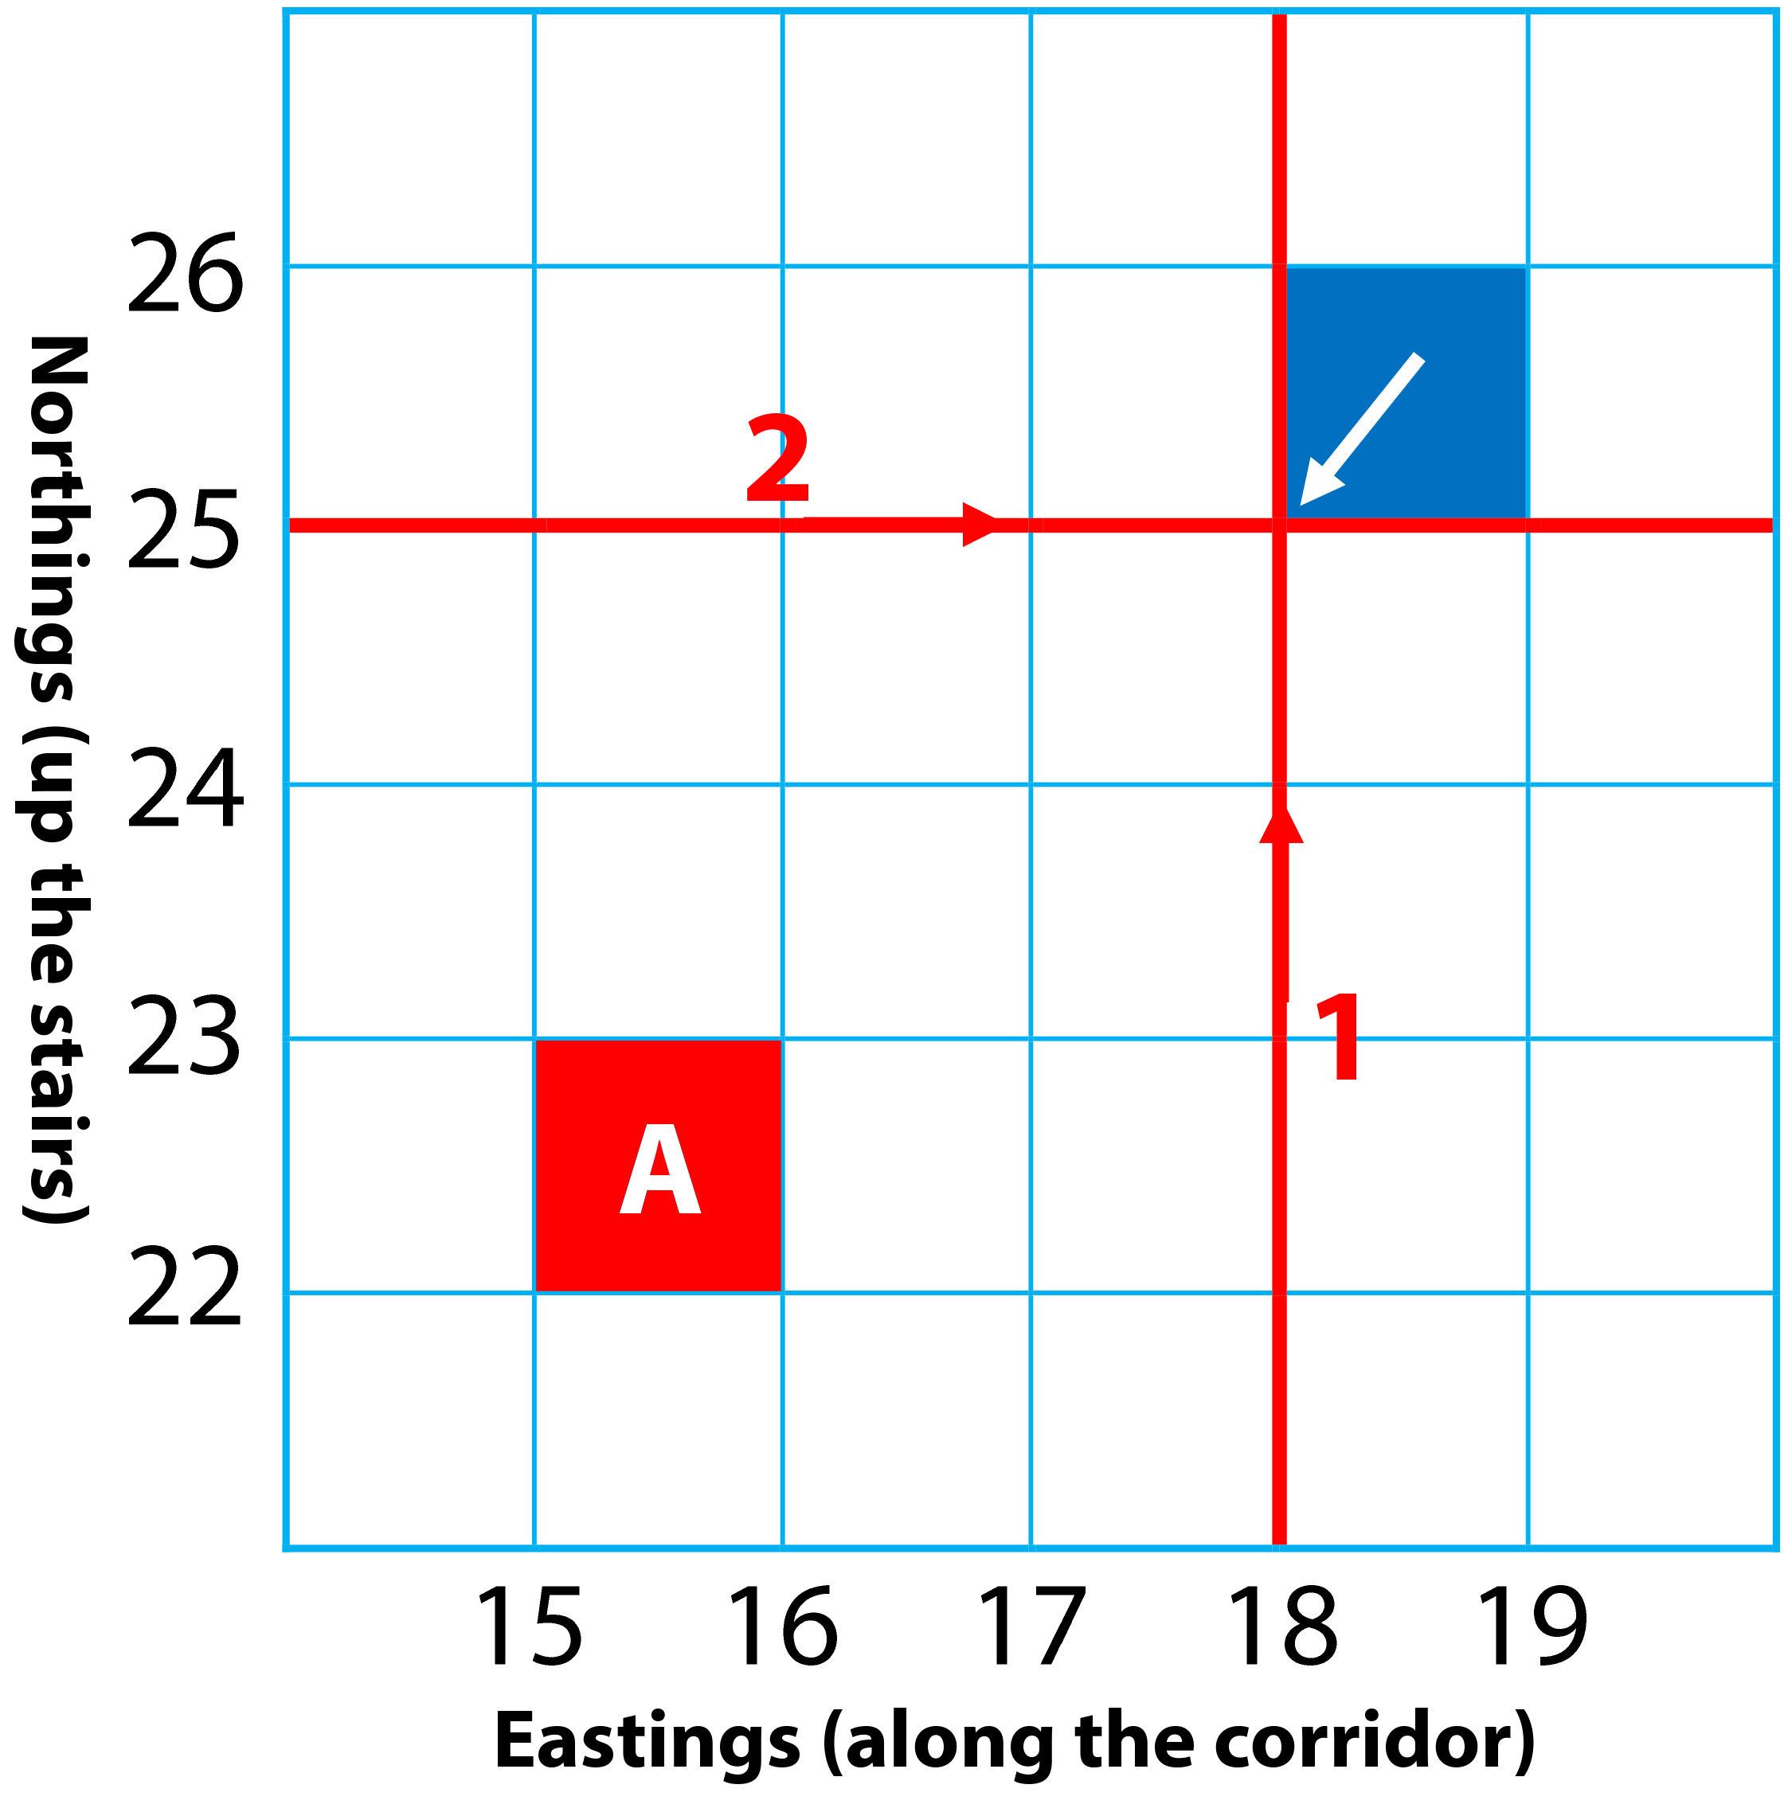
4-FIGURE GRID REFERENCES
Resource Book
Page 72
When giving a grid reference, you always find what the easting is first, then the northing.
So, the grid reference of the blue shaded square marked by the arrow would be:
Easting | Northing
18 | 25
Grid Reference
1825
Notes:
First find the number of the easting line (go along the corridor). Then find the number of the northing line (go up the stairs). This will give you the grid reference of the square.

Slide 8
4-FIGURE GRID REFERENCES
Resource Book
Page 72
What is the grid reference of square ‘A’?
Easting | Northing
15 | 22
Grid Reference
1522
Notes:
First find the number of the easting line (go along the corridor). Then find the number of the northing line (go up the stairs). This will give you the grid reference of the square.

Slide 9
4-FIGURE GRID REFERENCES
Resource Book
Page 72
Notes:
ORDINANCE SURVEY: HOW TO TAKE A 4-FIGURE GRID REFERENCE
The video is 1 minute and 52 seconds long. Please allow for this when planning session lengths. This video is from Ordinance Survey; more can be found on their YouTube channel.
A video explaining how to take a 4 figure grid reference.

Slide 10
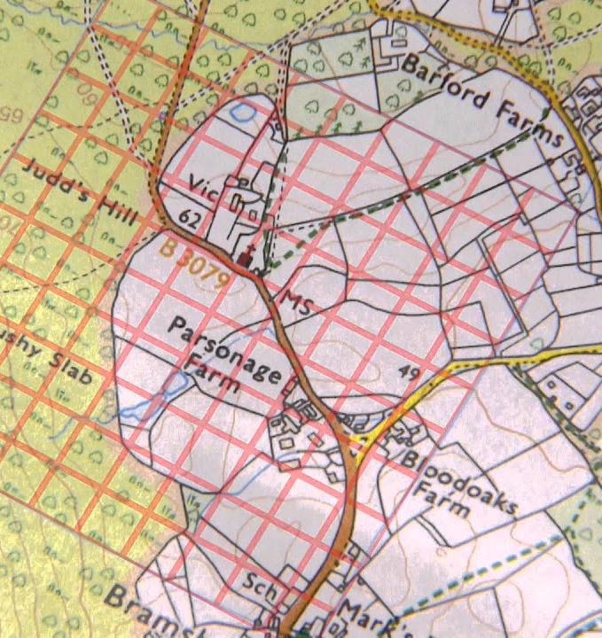
6-FIGURE GRID REFERENCES
Resource Book
Page 73
1km squares are quite large areas!
To find a 100m square area, you can use a 6 figure grid reference by dividing your maps grid square into smaller squares.
Notes:
This 4-figure reference system is a good method of pinpointing objects on the ground like a church or a farm but if there are more than one of the same object in that particular square it may get confusing. To overcome this problem you need to increase your accuracy. There is a system of 6-figure referencing you can use.

Slide 11
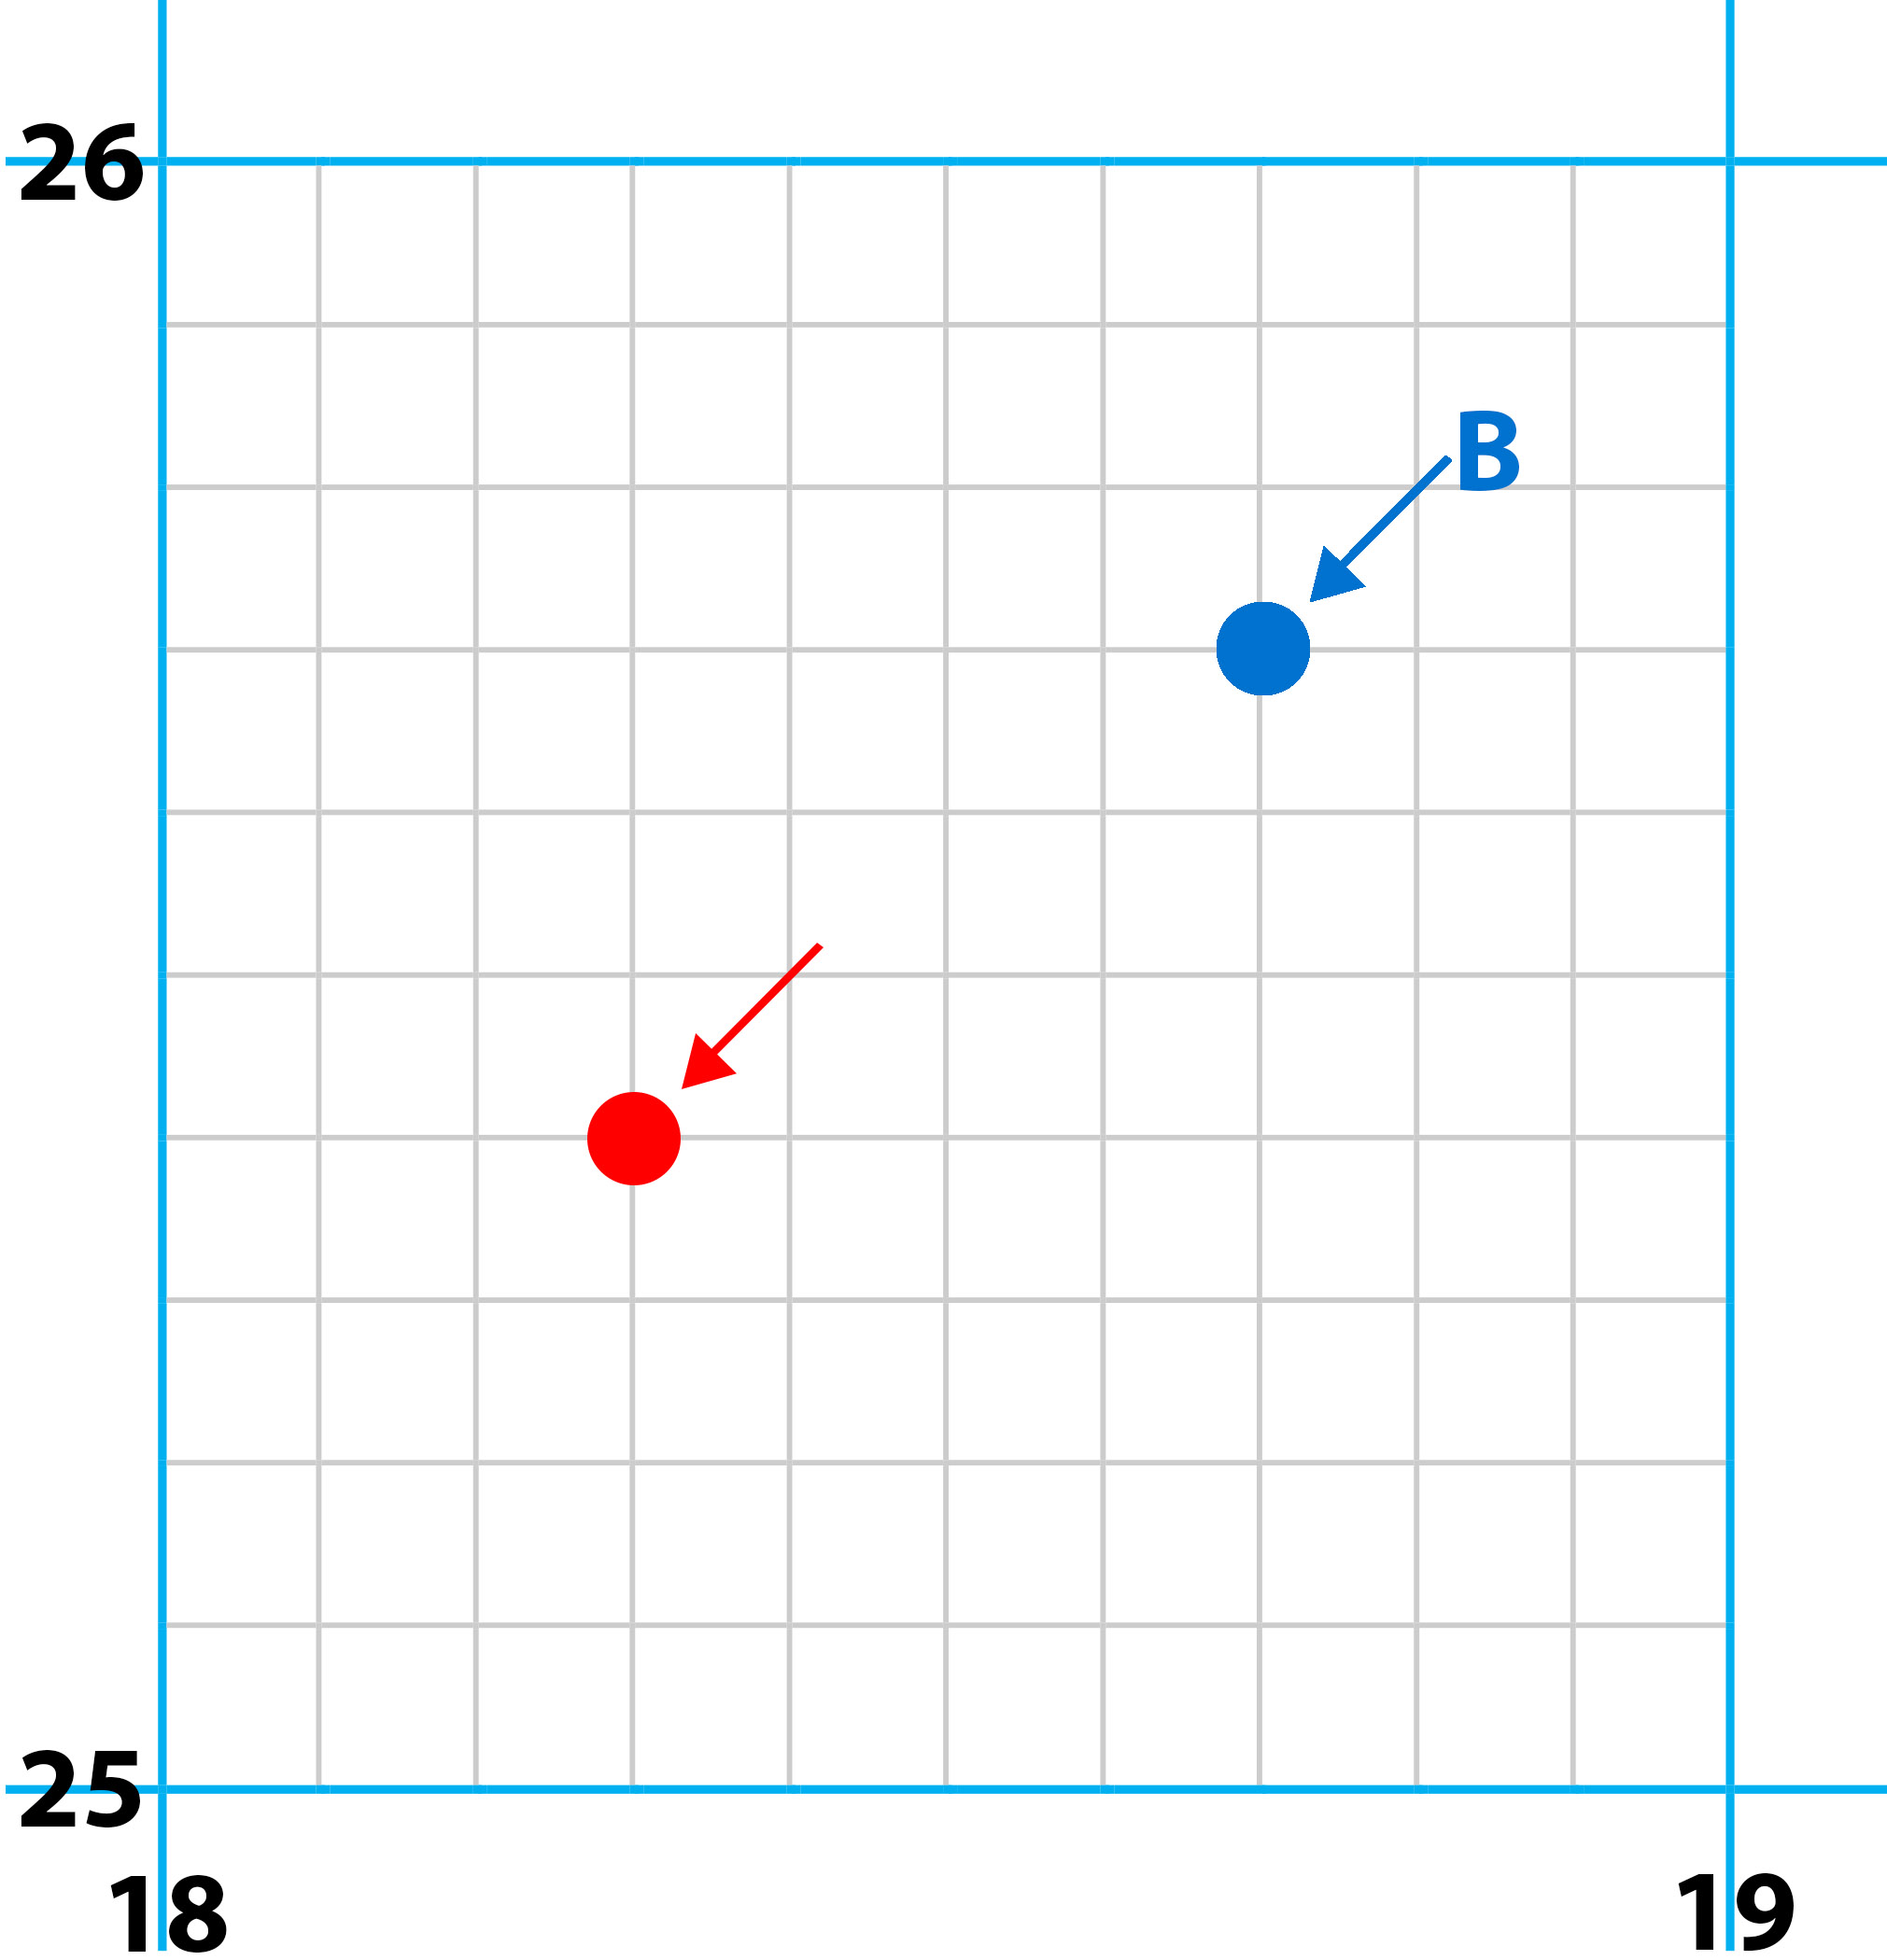
6-FIGURE GRID REFERENCES
Resource Book
Page 73
First Find the 4 figure grid reference
Leave a space after each number.
Like this:
Grid Reference
18__ 25__
Notes:
This 4-figure reference system is a good method of pinpointing objects on the ground like a church or a farm but if there are more than one of the same object in that particular square it may get confusing. To overcome this problem you need to increase your accuracy. There is a system of 6-figure referencing you can use.

Slide 12
6-FIGURE GRID REFERENCES
Resource Book
Page 73
Mentally divide the northings and eastings into ten parts.
The red dot is 3/10 across the easting.
4/10 up the northing.
Put the missing numbers in the gaps:
Grid Reference
183254
Notes:
1. Mentally divide the northings and eastings into ten parts.
2. Estimate how many tenths the object is into the square. E.g. the object shown in the diagram above would be 3/10 of the easting and 4/10 of the northing.
3. Take the four figure grid reference of the square containing the feature, leaving a gap after each of the numbers, like this: 18 25
4. Insert the number of tenths the object is into the square after the relevant figure in the 4 – figure reference. Remember to insert the tenths of the easting after the first number.

Slide 13
6-FIGURE GRID REFERENCES
Resource Book
Page 73
What is the grid reference of dot ‘B’?
Grid Reference
187257
Notes:
1. Mentally divide the northings and eastings into ten parts.
2. Estimate how many tenths the object is into the square. E.g. the object shown in the diagram above would be 3/10 of the easting and 4/10 of the northing.
3. Take the four figure grid reference of the square containing the feature, leaving a gap after each of the numbers, like this: 18 25
4. Insert the number of tenths the object is into the square after the relevant figure in the 4 – figure reference. Remember to insert the tenths of the easting after the first number.

Slide 14
6-FIGURE GRID REFERENCES
Resource Book
Page 73
Notes:
ORDINANCE SURVEY: HOW TO TAKE A 6-FIGURE GRID REFERENCE
The video is 2 minutes and 6 seconds long. Please allow for this when planning session lengths. This video is from Ordinance Survey; more can be found on their YouTube channel.
A video explaining how to take a 6 figure grid reference.

Slide 15
ANY QUESTIONS?
Are there any final questions?
?
Notes:
A chance to ask or answer any final questions.

Slide 16
LEARNING OUTCOMES
LO2: Know the scales and features of Ordnance Survey maps.
Use grid referencing systems on Ordnance Survey maps to find locations.
Notes:
LO2: Know scales and features of Ordnance Survey maps.
P3: Use grid referencing systems on Ordnance Survey maps to find locations.

Slide 17
GRID REFERENCE TASK 1
Logbook
Page 23
Using an OS map, find 3 features.
Give their 6 figure grid reference.
When this is complete your instructor should sign page 23 of your First Class Logbook and fill in the Task P3 Activity 1 Map Reading log sheet.
Notes:
This task covers the mandatory requirement for objectives P3 for LO2.
Cadets must use an OS map to find some of the land features discussed.
Once satisfied that all cadets have an understanding of the topic, instructors must fill in:
Page 23 of the cadet’s first class log book.
Task P3 Activity 1 log sheet. This can be found on Ultilearn.

Slide 18
GRID REFERENCE TASK 2
Logbook
Page 23
Look at the Potters Bar map and give the 6 figure grid references of the places marked by the 14 arrows.
When this is complete your instructor should check and sign page 23 of your First Class Logbook.
Notes:
This task covers the mandatory requirement for objectives P3 for LO2.
Cadets must used to provided map to give some 6-figure grid references.
The Potters Bar map can be found in the back of the First Class Log Book. A clearer version can be found in the First Class Cadet Instructor Handbook.
Once satisfied that all cadets have an understanding of the topic, instructors must check and sign:
Page 23 of the cadet’s first class log book.

Slide 19
INSTRUCTOR INFORMATION
This presentation is provided free of charge with the 1st class cadet training system with no warranty or support.
Every effort has been made to ensure the information is correct, but the author accepts no responsibility for any errors or omissions.
Official information on Ultilearn or Bader SharePoint should be checked before using these presentations.
These presentations may be distributed to other Air Cadet squadrons free of charge, but do not place them on the internet.
For best results, use with the 1st class resource book and 1st class instructor handbook, available from cadetdirect.com.
Version 19/04

