Slide 1
Notes:
Part 2 of 4. This presentation covers the information required to complete PASS criteria of the LO2 Initial Expedition Training topic.
For best results, these instructor notes should be read in conjunction with this presentation and the lesson plan.

Slide 2
LEARNING OUTCOMES
LO2: Be able to use tents and carry equipment safely.
Demonstrate the erection of tents for a walking expedition.
Notes:
LO2: Be able to use tents and carry equipment safely.
P5: Demonstrate the erection of tents for a walking expedition.

Slide 3
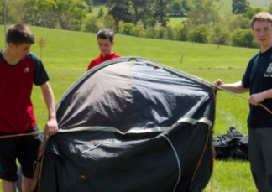
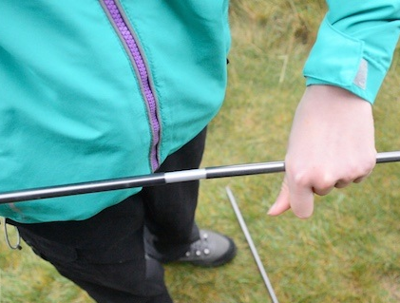
PITCHING A TENT
Resource Book
Page 87
Pitching a tent can be a challenge for those who have not done it before.
Some tents are quite complicated to set up and may need more than one person to put up safely.
It is vital that you practice putting up the tent you are going to use several times before you actually go out and use it on expedition.
Cold or wet weather can make a tent much harder to put up.

Slide 4
PUTTING UP YOUR TENT
Resource Book
Page 87
Some tents are pitched with the outer tent first:
First add the poles to the outer sheet
Peg down the outer sheet with the poles attached.
Crawl inside and clip the inner sheet inside.
Inner sheet can be left inside for quicker pitching next time.
Fig 1: Poles and Outer
Fig 2: Inner sheet (orange) now clipped inside.
Notes:
Outer first tents are pitched with the outer sheet first. The poles are inserted into slots on the outer sheet (these are often colour coded – i.e. Red pole into slot with the red tag). Once this is done the tent will have it’s shape and can be pegged out. Once this is done someone can crawl inside and attach the inner sheet into the outer ‘shell’ of the tent. The inner can be left in when the tent is taken down, this will mean next time the tent is put up the only thing that needs to be done is insert the poles and peg it down.

Slide 5
PUTTING UP YOUR TENT
Resource Book
Page 87
Some tents are pitched with the inner tent first:
First add the poles to the inner.
Peg out the inner tent.
Throw the outer sheet over the top and align the outer door with the inner door.
Peg the outer sheet.
Fig 1: Poles and inner
Fig 2: Outer sheet (green) now pegged over the top.
Notes:
Inner sheet tents are pitched starting with the inner sheet. Poles are attached to the inner sheet, and this gives the shape of the tent. The inner is then pegged out. The outer sheet is then thrown over the top and the doors aligned. The outer sheet can then be pegged out.

Slide 6
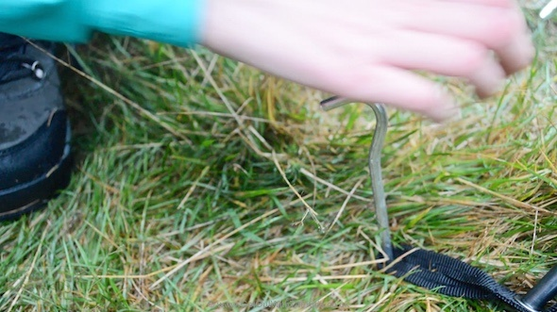
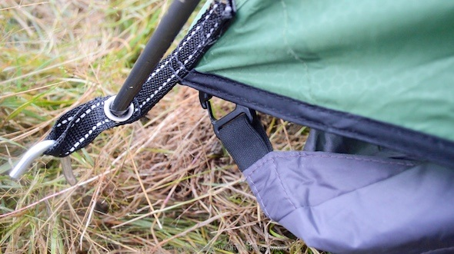
TENT PEGS
The end of a tent peg should be pointed inwards towards the tent.
Don’t place it straight down or away from the tent.
Pegging down a tent properly protects it from high winds.
Notes:
When pegging tents, always ensure that the end of the peg is pointing inwards towards the tent, and not straight down or away from the tent. This will provide maximum strength, particularly in the wind.

Slide 7
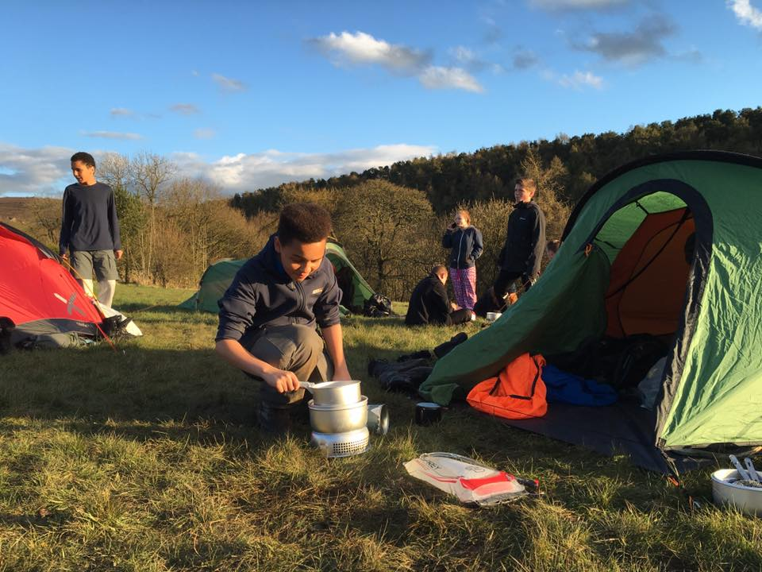
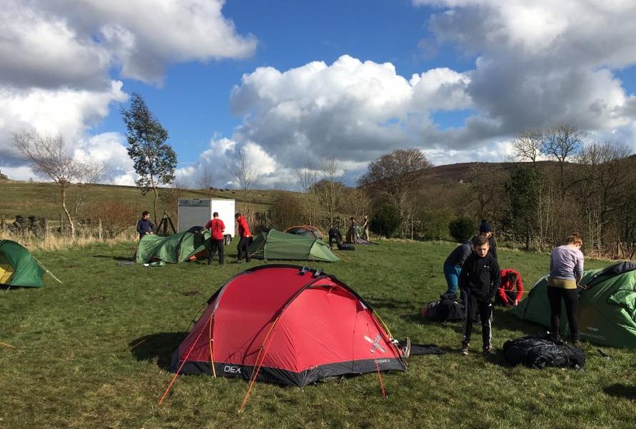
SITING A TENT
Resource Book
Page 87
Choose a good spot to site your tent for a good nights sleep!
Find shelter from prevailing winds and site on flat land which safe from potential flooding.
Don’t pitch tents directly below trees and remove any stones or sticks from underneath a tent.
Keep your tent at least 2 metres away from other tents.
Notes:
Choosing a good spot for a tent will help you to get a good night’s sleep and protect you from potential annoyance or inconvenience.
Try and find shelter from prevailing winds and flat land safe from potential flooding (usually at least 50 metres away from rivers or other water). Don’t pitch tents directly below trees; water will fall off the tree onto the tent.
Don’t place stones on the tents guide ropes, use pegs to secure them.
Remove any stones or sticks from underneath a tent. When you are lying down they are surprisingly noticeable, even under a roll mat!

Slide 8
ANY QUESTIONS?
Are there any final questions?
?
Notes:
A chance to ask or answer any final questions.

Slide 9
LEARNING OUTCOMES
LO2: Be able to use tents and carry equipment safely.
Demonstrate the erection of tents for a walking expedition.
Notes:
LO2: Be able to use tents and carry equipment safely.
P5: Demonstrate the erection of tents for a walking expedition.

Slide 10
TENT TASK
Logbook
Page 33
Put up and take down a tent in pairs.
When this is complete your instructor should sign page 33 of your First Class Logbook and fill in the Task P4 Activity 1 Initial Expedition Training log sheet.
Notes:
This task covers the mandatory requirement for objectives P5 for LO2.
Cadets must erect, strike and re-pack a tent. This could be turned into a competition in small teams, to see who can complete the exercise the quickest.
Once satisfied that all cadets have an understanding of the topic, instructors must fill in:
Page 33 of the cadet’s first class log book.
Task P5 Activity 1 log sheet. This can be found on Ultilearn.

Slide 11
LEARNING OUTCOMES
LO2: Be able to use tents and carry equipment safely.
Demonstrate methods of kit packing for an expedition
Notes:
LO2: Be able to use tents and carry equipment safely.
P6: Demonstrate methods of kit packing for an expedition

Slide 12
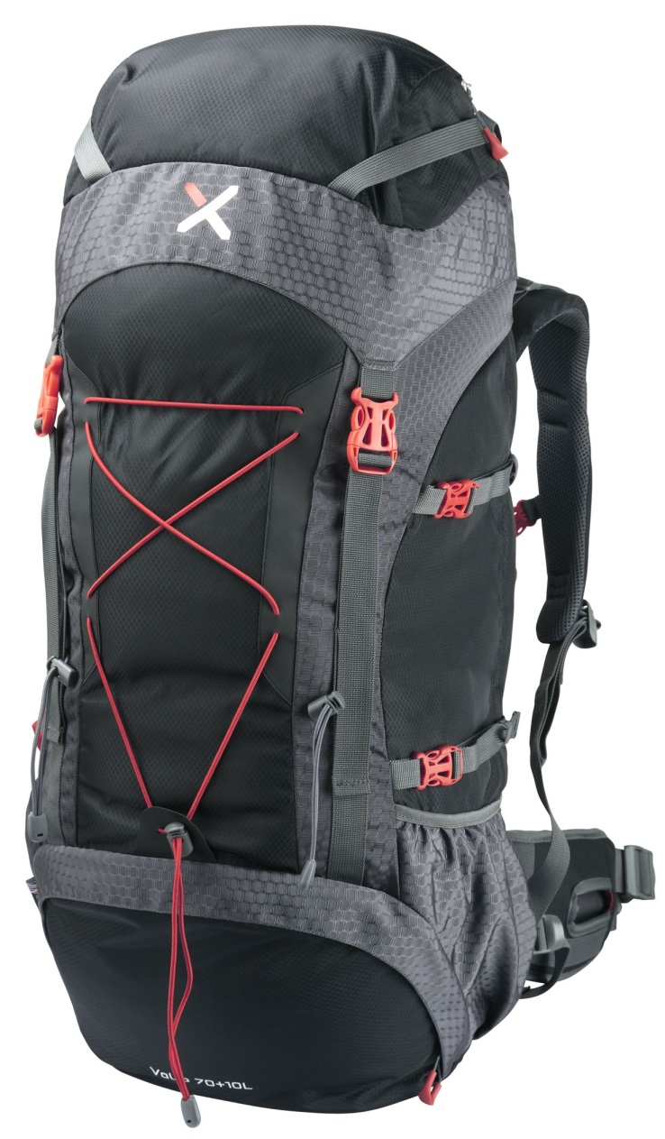
CHOOSING A RUCKSACK
Resource Book
Page 86
When considering selection of a rucksack, consider the following:
Size of rucksack.
Is it gender specific?
Thickness of straps.
Attachment points for equipment.
Notes:
Size of rucksack: cadets will need a rucksack of at least 65L for an expedition in order to accommodate all of their expedition kit.
Is it gender specific: some rucksacks are specific to male or female.
Thickness of straps: thicker straps are more comfortable.
Attachment points for equipment: do you need places to attach tent, roll mat etc outside of the main compartment.

Slide 13
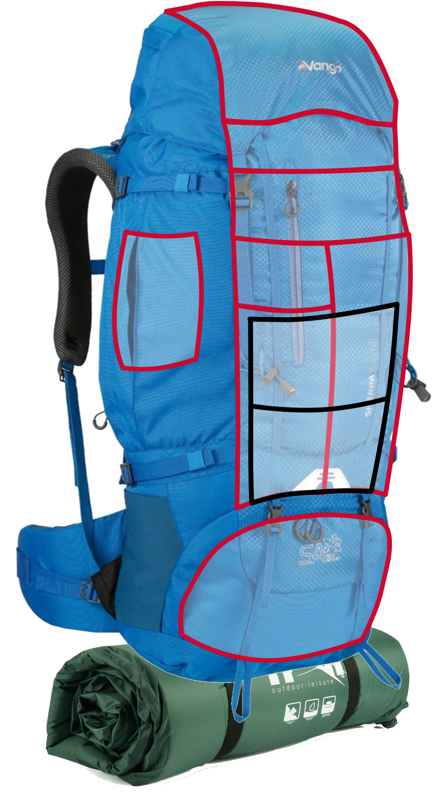
PACKING A RUCKSACK
Snacks
First Aid Kit
Head Torch
Sun-cream
Pocket Tool
Toilet Paper
Resource Book
Page 84
Loading a bag correctly is all about weight distribution and making sure frequently used items are close at hand.
Putting items in the correct place will make your bag much more comfortable to wear.
Waterproofs
Hat and Gloves
Food
Wash Kit
Survival Bag
Water
Tent
Sleeping Bag
Camping Kit
Clothes
Gas
Cooking Equipment
Stove
Camping Mat
Notes:
Equipment you need quickly: place this close to the top or in a lid pocket to avoid having to empty your bag out to get things you will need frequently.
Heavier equipment: best at the bottom, putting it at the top will mean that you are being off-balanced by the weight being higher up.
Water: water bottles in side pockets or use a hydration system such as a camelbak.
Roll mat: stored outside wherever is best, consider covering it in a bag to avoid it getting soaked.
Liquid fuel: outside and ideally waterproofed.

Slide 14
ANY QUESTIONS?
Are there any final questions?
?
Notes:
A chance to ask or answer any final questions.

Slide 15
LEARNING OUTCOMES
LO2: Be able to use tents and carry equipment safely.
Demonstrate methods of kit packing for an expedition
Notes:
LO2: Be able to use tents and carry equipment safely.
P6: Demonstrate methods of kit packing for an expedition

Slide 16
RUCKSACK PACKING TASK
Logbook
Page 33
Demonstrate how to pack a 65-75 litre rucksack for an overnight expedition.
When this is complete your instructor should sign page 33 of your First Class Logbook and fill in the Task P6 Activity 1 Initial Expedition Training log sheet.
Notes:
This task covers the mandatory requirement for objectives P6 for LO2.
In order to complete the assessment for this task, cadets must give a presentation in which they prepare and bring in a 65-75 litre rucksack suitable for an overnight expedition. They must unpack the rucksack and explain the reason why each item was packed as and where it was. Instructors should also check that the cadet understands the importance of carrying a rucksack comfortably and safely (including shoulder straps, waist band and chest strap).
THIS CAN BE PAIRED WITH TASK P4 for LO1.
Once satisfied that all cadets have an understanding of the topic, instructors must fill in:
Page 33 of the cadet’s first class log book.
Task P6 Activity 1 log sheet. This can be found on Ultilearn.

Slide 17
INSTRUCTOR INFORMATION
This presentation is provided free of charge with the 1st class cadet training system with no warranty or support.
Every effort has been made to ensure the information is correct, but the author accepts no responsibility for any errors or omissions.
Official information on Ultilearn or Bader SharePoint should be checked before using these presentations.
These presentations may be distributed to other Air Cadet squadrons free of charge, but do not place them on the internet.
For best results, use with the 1st class resource book and 1st class instructor handbook, available from cadetdirect.com.
Version 19/04

